Slide 1

EFFECTIVE PATTERN DISCOVERY FOR TEXT MINING
By-
M.N.M Pradeep (11K81A0583)
M.Saikrishna (11K81A0584)
Raghunandan.G (11K81A05A0)
Sania Alex (11K81A05A2)

Slide 2
ABSTRACT
Many data mining techniques have been proposed for mining useful patterns in text documents.
However,how to effectively use and update discovered patterns is still an open research issue.
This paper presents an innovative and effective pattern discovery technique which includes the processes of pattern deploying and pattern evolving, to improve the effectiveness of using and updating discovered patterns
Substantial experiments on RCV1 data collection and TREC topics demonstrate that the proposed solution achieves encouraging performance.

Slide 3

EXISTING SYSTEM
Most existing text mining methods have adopted term-based approaches, which suffer from the problems of polysemy and synonymy.
People have often held the hypothesis that pattern (or phrase)-based approaches should perform better than the term-based ones, but many experiments do not support this hypothesis.

Slide 4
PROBLEMS IN EXISTING SYSTEM
Phrases have inferior statistical problems to terms.
They have low frequency of occurrence.
There are large number of redundant and noisy phrases among them.

Slide 5

PROPOSED SYSTEM
We present an effective pattern discovery technique, which first calculates discovered specificities of patterns and then evaluates term weights according to the distribution of terms in the discovered patterns.
It considers the influence of patterns from the negative training examples to find ambiguous (noisy) patterns and try to reduce their influence for the low-frequency problem.

Slide 6
ADVANTAGES OF PROPOSED SYSTEM
The proposed approach can improve the accuracy of evaluating term weights because discovered patterns are more specific than whole documents.
To avoid the issues of phrase-based approach we use the pattern-based approach.
Pattern mining techniques can be used to find various text patterns.

Slide 7
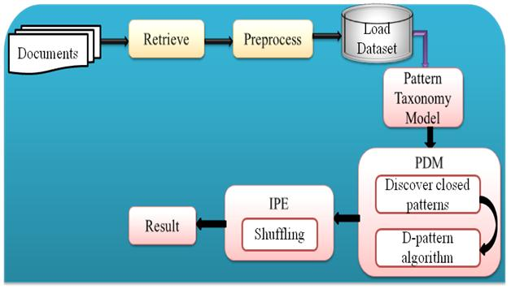
SYSTEM ARCHITECTURE

Slide 8
H/W System Configuration
Processor – Pentium IV 2.4 GHz.
Speed - 1.1 Ghz
RAM- 256 MB(min)
Hard Disk - 20 GB
S/W System Configuration
Operating system : Windows XP and IIS
Coding Language : ASP.Net with C#
Server : SQL Server 2008.

Slide 9
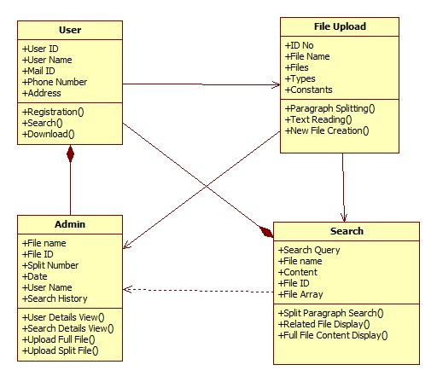
CLASS DIAGRAM

Slide 10
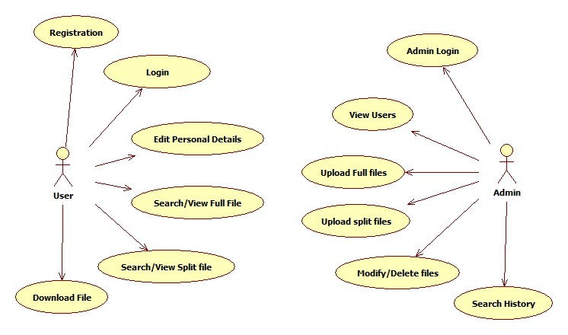
USECASE DIAGRAM

Slide 11
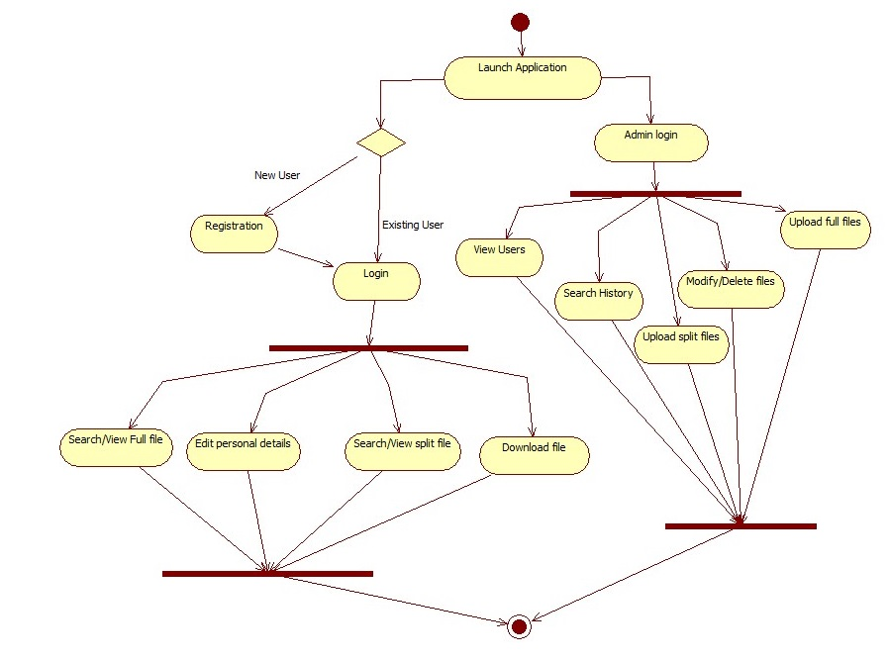
ACTIVITY DIAGRAM

Slide 12
SEQUENCE DIAGRAM

Slide 13
COLLABORATION DIAGRAM

Slide 14
SCREENSHOTS

Slide 15
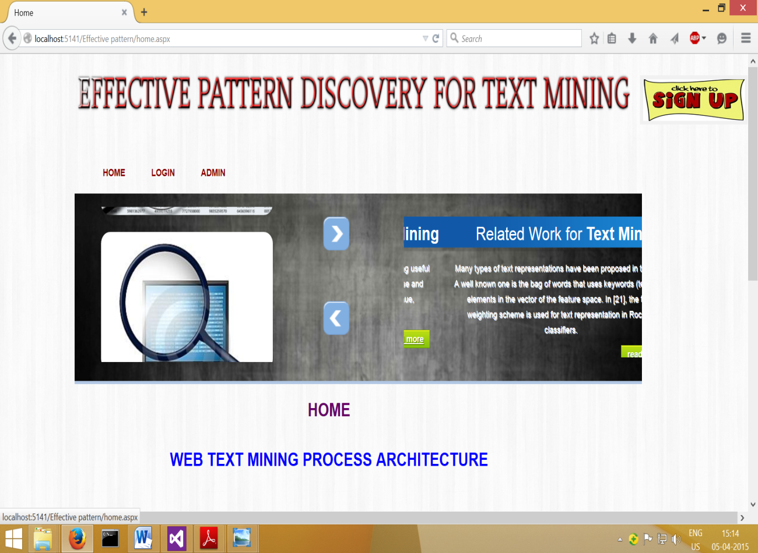
Home page

Slide 16

Registration page

Slide 17
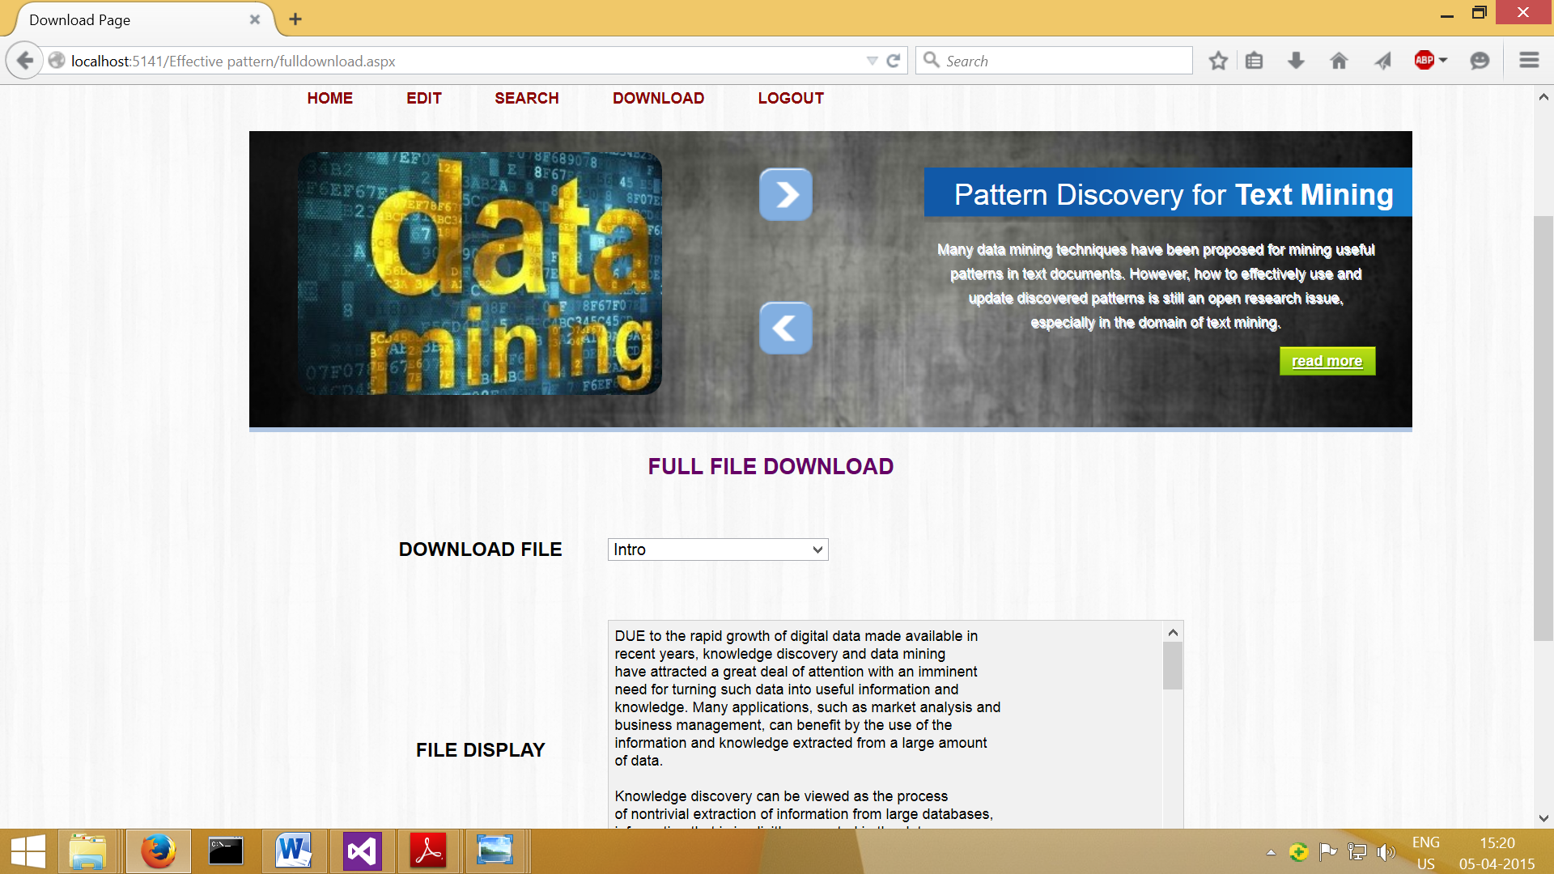
User can download full files by selecting file name

Slide 18

User can search a file and download it to the system

Slide 19
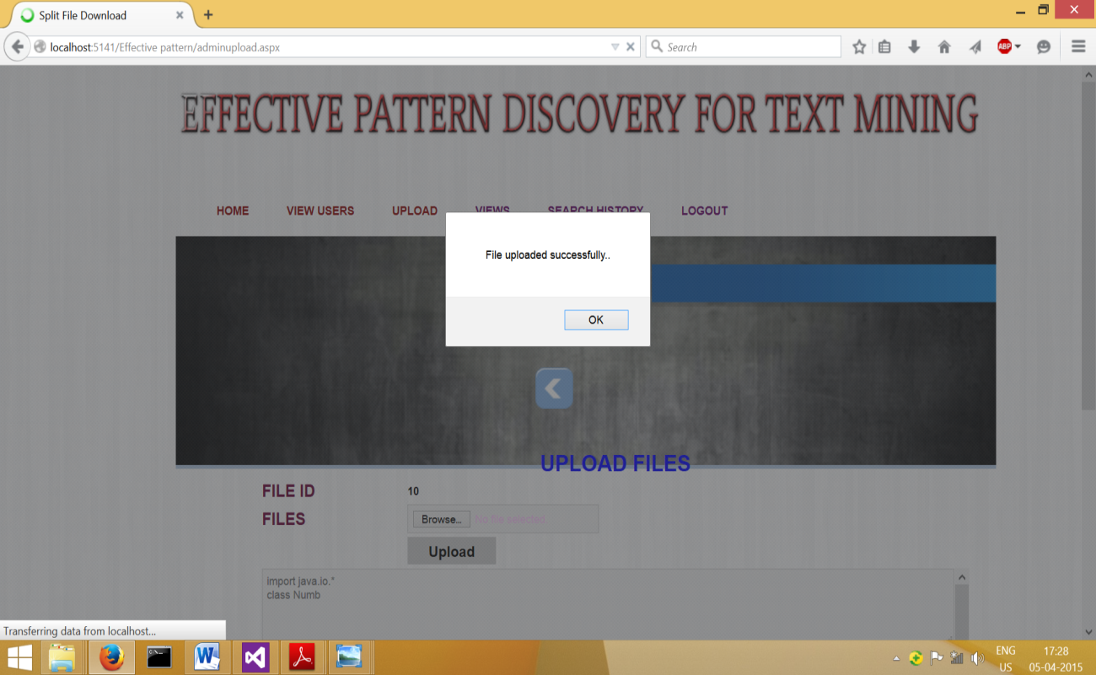
Admin can upload files

Slide 20
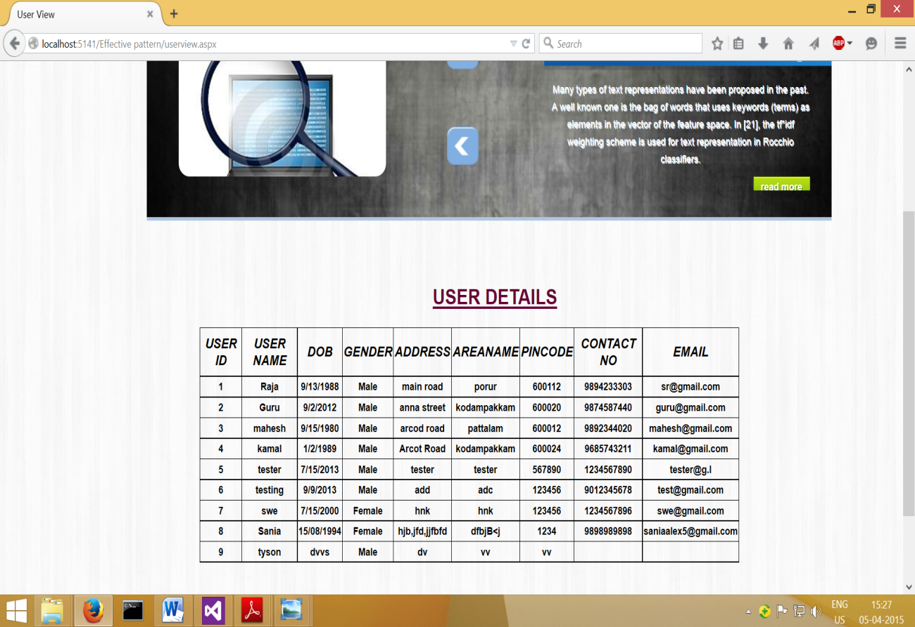
Admin can view all details of the registered users

Slide 21
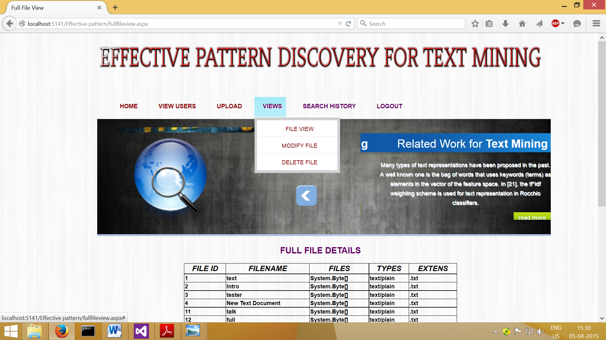
Admin can make changes to the files

Slide 22
CONCLUSION
Many data mining techniques have been proposed in the last decade. However, using these discovered knowledge (or patterns) in the field of text mining is difficult and ineffective. The reason is that some useful long patterns with high specificity lack in support i.e., the low frequency problem. The proposed technique uses two processes, pattern deploying and pattern evolving, to refine the discovered patterns in text documents. The experimental results show that the proposed model outperforms not only other pure data mining-based methods and the concept based model, but also term-based state-of-the-art models

